Slide 1
Designing for Common Problems in SQL Server
Louis Davidson (drsql.org)
drsql@hotmail.com

Slide 2
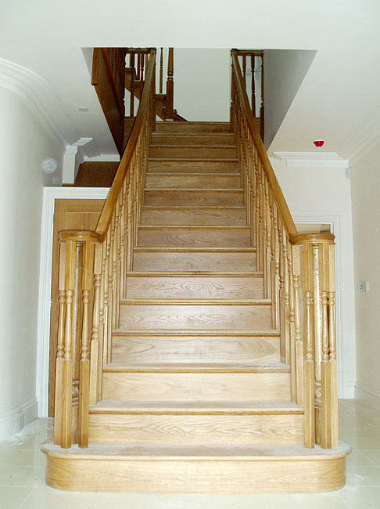
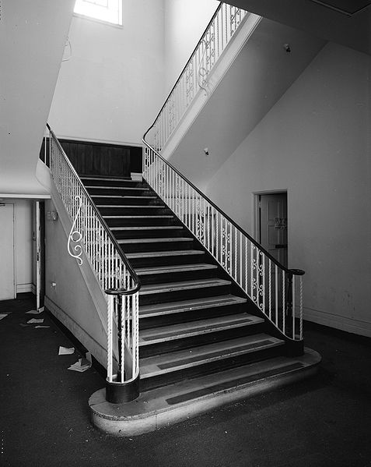
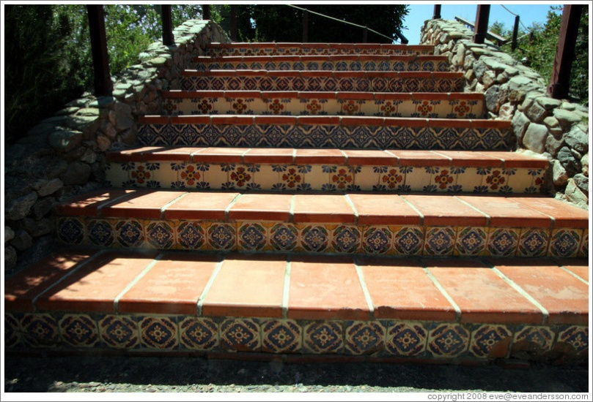
Problem Solutions = Design Patterns
Everything is easier if you generally do common tasks in a common way, don’t reinvent the wheel, and all that

Slide 3
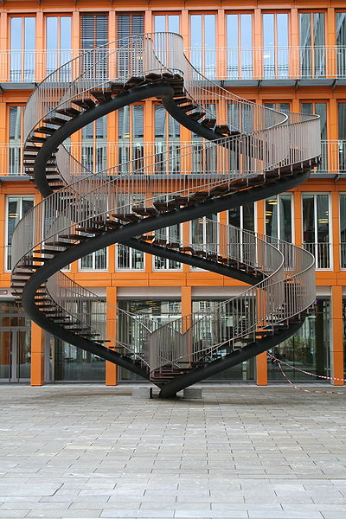
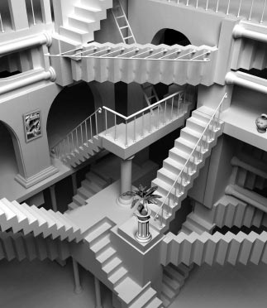
But apply a pattern incorrectly..
Designed by committee!

Slide 4
Planning ahead or change direction
Great design demands you plan ahead
You don’t have to implement the entire hotel to build the stairs well
But you do have to know what the hotel is probably going to look like…
Without planning, many implementations look like a Rube Goldberg Comic strip

Slide 5
Rube Goldberg Comic

Slide 6
Database Design Patterns
Patterns we follow over and over again to build new and “exciting” stuff
Done right, makes it easy to identify what the schema represents because you (and the users!) have seen it all before.
Two major patterns are common with SQL Server
Relational – For OLTP, read/write usage pattern
Dimensional – For reporting/read operations
Each of these has sub patterns for solving specific problems

Slide 7
Followed patterns help to deciphering the output (Model)
Data can be stored in many ways/places in a model
Must be careful to understand semantics of where attributes are placed in the model
Just because you can get the result you need from your query doesn’t mean that it means what you want it to
Very common mistakes are made by people who design without considering the entire model
Information should be stored once, even though data may look duplicated

Slide 8
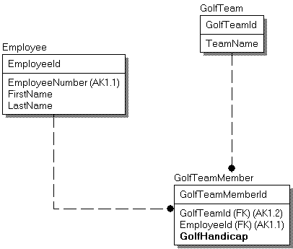
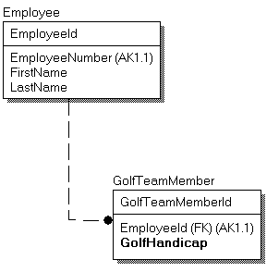
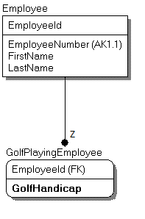
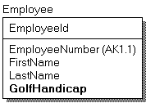
Example
Primary Goal: Store employee’s golf handicap

Slide 9
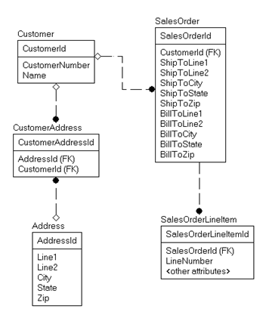
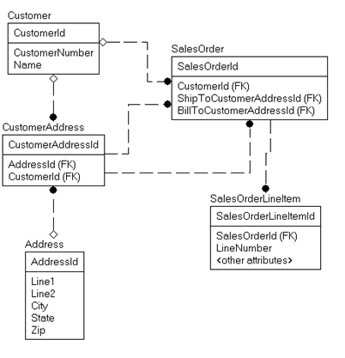
Keys or Copies?
Keys
Copies

Slide 10
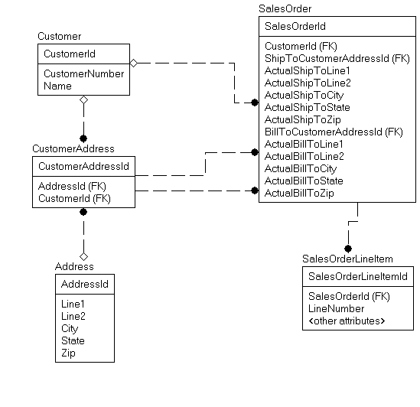
Both? “It depends…”
Represents “As Of” Value of Customer Address
Represents “Current” Value of customer Address

Slide 11
Requirements Matter
Your design to match the requirements
Given: So you do what the customer expects
Needed: So you can do what the customer really wants
Any database design can be right without knowledge of the requirements

Slide 12
Agenda
Uniqueness: Realistic patterns of solutions that often cannot be implemented with a simple uniqueness constraint
Data-driven design: Never hard-code values that don’t have a fixed meaning
Storing user-specified data: Possibilities for letting users extend their database themselves in a manner that can be somewhat controlled by the administrators

Slide 13
Agenda - Continued
Files: Storing images and documents using SQL Server (or not)
Hierarchies: Introducing methods of implementation and a few other methods that you can explore
Generalization: In this section, we will look at some ways that you will need to be careful with how specific you make your tables so that you fit the solution to the needs of the user.
Dimensional Design: Optimizing for analysis of a data set (data warehousing)

Slide 14
Uniqueness
As I mention at least 100 times a day, by definition, a table has unique rows
Every table should have a natural key if possible
There are a few common examples where this isn’t possible
Logging Tables – Where the event is the thing, and time of event may not be unique enough
Incomplete Uniqueness, Bulk Uniqueness (Discussed later)

Slide 15
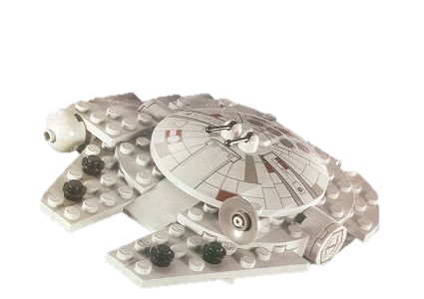
Natural/Artificial Keys
Requirement: Table of Lego Sets
Always find some other key to protect against duplicate data so you don’t end up with
~~~~~~~~~~~
LegoSetId Name =========== ----------- 1 M Falcon 4567 M Falcon 979796 M Falcon
Scale -----------
Minifig Micro Minifig
SetNumber -----------
7965 4488 10179
LegoSetId Name Scale SetNumber =========== ----------- ------------ ------------- 1 M Falcon Minifig 4488 4567 M Falcon Minifig 4488 979796 M Falcon Minifig 4488

Slide 16
Uniqueness Patterns
Basic Uniqueness – Data in column(s) must be unique across all rows in table
Typical case. Implemented using Primary Key or Uniqueness Constraint
Note: avoid using index for uniqueness when possible.
Selective Uniqueness – Sometimes you may have multiple key possibilities, but none that can be required
Only enforce uniqueness amongst some rows, situationally
Examples: Worker table with a column for EmployeeId and ContactorId stored seperately; Driver’s License Numbers, User Name for Active Employees, Email Address for a web account
Implement with:
2008+ – Filtered Index (Add WHERE clause to CREATE INDEX statement)
2000 and 2005 – Indexed View that filters values to be ignored
Earlier – Triggers
Alternative: Separate table with only rows that have the key value

Slide 17
Uniqueness Patterns - Continued
Range Uniqueness – Making sure ranges don’t overlap. Most common example: date ranges
Bulk Uniqueness – Types of objects are unique, but not each individual item
Example: Goods/Products, pretty much any thing you need to track where you can’t tell items apart
Has some difficulty in implementing due to: Stolen items, Broken items, Miscounted items
Two common solutions:
1 Row Per Physical Item – Requires tagging of items. Generally infeasible for most items, but certain high value items can apply
1 Row/Set of Rows Per Type of Item – Common solution, simply count the number of items on hand and decrement as items used/removed

Slide 18
Uniqueness Patterns - Continued
Approximate Uniqueness – Might not be unique, but it is likely
Examples: Account information: Various combination of Names, Addresses, Phone Numbers
Often you will be required to combine rows that are discovered to be the same after the fact
Implemented outside of the database constraints, but should be a part of the database design process (metadata can be identified in extended properties)

Slide 19
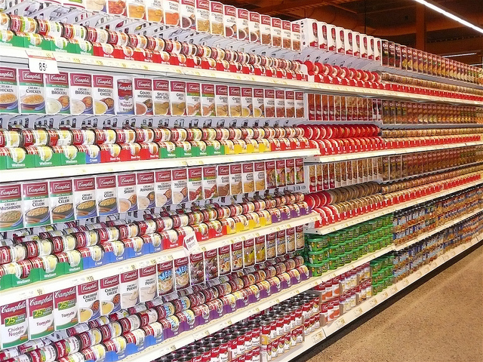
Uniqueness Grain
As the designer, it is critical to understand a what grain you can provide uniqueness to your customer
Approximate Uniqueness is the most challenging, but often the most important
In the overall picture of database design, uniqueness is the most important thing to get right.
Why? How much money do you spend with/give to organizations that send you multiple correspondence each month?
http://www.flickr.com/photos/28633851@N05/4728938858/

Slide 20
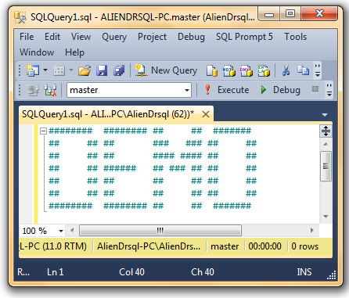
Basic, Selective and Range Uniqueness

Slide 21
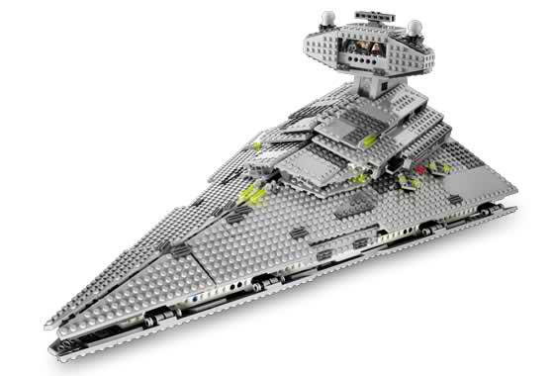





Inventory Design
A certain person was obsessed with their Lego collection. He had thousands of them, and wanted to catalog his Legos both in storage and in creations they were currently located and/or used. Legos are either in the storage “pile” or used in a set. Sets can either be purchased which will be identified by an up to 5 digit numeric code, or personal that has no numeric code. Both styles of set should have a name assigned and a place for descriptive notes.
Legos come in many shapes and sizes, with most measured in 2 or 3 dimensions. First in width and length based on the number of studs on the top, then sometimes based on a standard height (example: bricks have height, plates are fixed at 1/3 of 1 brick height unit). Each part comes in many different standard colors as well. Beyond sized pieces, there are many different accessories (some with length/width), instructions, etc. that can be catalogued.
Example pieces and sets:
1x3 Plate
1x2x3 Door
2x1x1 Brick
1x1x5 Brick
1x3x1 Slope
Imperial Battle Cruiser Set

Slide 22
Simple inventory model

Slide 24
Data Driven Design
Structure of data should represent the requirements and needs “flexibly”
Location of logic/rules/protection logic
Schema
Constraints, Triggers
Stored Procedures
App Code
Ideally, business logic handled by data and joins
Adding data similar to existing data should not result in code change!

Slide 25
Data Driven Design Code Example
Bad:
IF @customerId in ('1', '2') Do ActionA(@customerId) ELSE IF @customerId in ('3') Do ActionB(@customerId) OTHERWISE Do ActionC(@customerId)
Better:
IF @customerType = 'Great’ Do ActionA(@customerId) ELSE IF @customerType = 'Good’ Do ActionB(@customerId) OTHERWISE Do ActionC(@customerId)
Now, adding a new row with common traits is a snap
Code need only be added if you need a totally new type that implements a ‘SuperWonderful’ customer type

Slide 26
Data Driven Design Principle Point
The more you data drive the design, the less support needed
You test the heck out of the thing, making sure that users can set their data in any configuration desired
Costs are affected
Upfront costs increased (More possible configurations means more flexibility, more flexibility means more testing)
Maintenance costs can be significantly decreased, particularly for volatile data scenarios

Slide 28
Generalization
Combine foundationally similar tables into a single table
Look for similarities in utilization, columns, etc.
Avoid losing meaning of the data being stored
Generalization often uses sub-classing to maintain independence while matching requirements
Result:
Data driven design
Fewer tables
Easier to extend
Overly Simple
Overly Complex
One Table (Gelatinous Blobs)
Specific Tables (Molecular Structures)

Slide 29
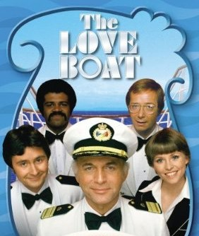

Generalization Example

Slide 30
Generalization Example
Tango Dances
Snorkeling
Shark Feeding
Cruise Ship Activity Schedule
Polka Dances
Tango Dances
Snorkeling
Shuffleboard
Captain Dinners
Aerobics
Shore Excursion
Swimming Lesson
Shark Feeding
Polka Dances
Captain Dinners
Swimming Lessons
Passenger
TimePeriod
Shore Excursion
Aerobics
Location
Passenger Activity

Slide 31
Generalization Example
Cruise Ship Activity Schedule
Polka Dances
Tango Dances
Snorkeling
Shuffleboard
Captain Dinners
Aerobics
Shore Excursion
Swimming Lesson
Shark Feeding
ActivityType
Staff
SpecificActivity
TimePeriod
Activity Staff
Activity Offering
Location
Passenger
Passenger Activity
Still may need to expand to handle complex staffing requirements

Slide 32
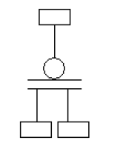
Subtypes
Allows extending a general entity to allow for specific information/business rules to be managed naturally instead of with complex expressions
Relationships will be one to one identifying relationships with the only key in the child being the pk of the parent.
Child Items should have additional columns/relationships in order to need the subtype at all
Use when you need to treat sub-type items independently AND as a group

Slide 33
Subtype Example
Requirements: Small school database. Grades 1-12, with four subdivisions of students. Senior year activities are different than other levels.
Elementary
Student
Middle
Junior High
High School

Slide 34
Subtype Example
Requirements: Small school database. Grades 1-12, with four subdivisions of students. Senior year activities are different than other levels.
Elementary
Z
Student
Middle
Z
Junior High
Z
Only one active subtype row, but may have previous rows tied to specific activity in earlier years
High School
Senior
Z
Z

Slide 35
Partial DDL For School DB
CREATE TABLE Student ( StudentId int PRIMARY KEY, StudentType varchar(30) CHECK…) …
CREATE TABLE MiddleSchoolStudent ( StudentId int PRIMARY KEY REFERENCES Student(StudentId),…)
CREATE TABLE HighSchoolStudent ( StudentId int PRIMARY KEY REFERENCES Student(StudentId), StudentLevel varchar(30) CHECK…) CREATE TABLE SeniorHighSchoolStudent ( StudentId int PRIMARY KEY
REFERENCES HighSchoolStudent(StudentId)

Slide 36
Interfaces
Use to allow objects to have common functionality
Use when commonality isn’t sufficient for subclassing
The related objects needn’t share any commonality
Company
Contractor
Payee
Address
Office
Employee

Slide 37
Partial DDL for Interface Example
CREATE TABLE Address (AddressId Int PRIMARY KEY, InterfaceType Varchar(30) CHECK (InterfaceType in …)
…
CREATE TABLE Contractor (ContractorId Int PRIMARY KEY, AddressId Int UNIQUE /*Optional*/ REFERENCES Address(AddressId),…)
CREATE TABLE Office (OfficeId Int PRIMARY KEY, AddressId Int UNIQUE /*Likely for location*/ REFERENCES Address(AddressId),…)

Slide 38

Generalize, Subclass, Or Both?
Person
Pet Store Objects
Clerk
Dog
Cat
Hamster
Ferret
Customer
Manager
Weasel
Iguana
Animal
What’s all this Weasel bashing? Stop bashing managers, the popular opinion says they are our friends.
OwnedPets
Pets
Employee
Customer
Z
Z
Z
Z
Dog
Cat
Manager
Clerk
SignUp

Slide 39

LEB National Bank - Discussion
At the Large Evil Bank (LEB), they have 6 types of accounts including mortgages, credit card, checking, saving, etc. Each account type shares many of the same characteristics, customer, balances, etc, but obviously each type of account has characteristics that are different.
Assume that each account type has 5 or 6 columns that are specific for each type of account. For example, a mortgage account has assets that secure the loan, while a credit card has limits (both by day and total)
Larger Number of Attributes Would your design change if there were multiple order of magnitude more specific attributes for the specific types of accounts?
You were warned. No more bashing my friends. People are completely satisfied with the dynamic experience their bank provides.

Slide 40
For more explanation about the weasel
http://insurancewriter.com/blog/2010/08/27/weasel-words-weaken-your-message/

Slide 42
User Specified Schema
Try as we might, we cannot predict every user need for the rest of eternity
User needs mutate over time
Hence, we need to come up with a plan for how to accommodate user needs that were not known (or possible to implement) at design time
Patterns:
Big ‘ole list of generic columns
EAV – Entity Attribute Value
Allowing client to add extra columns to table
Solution can be greatly affected by type of dev (Software Vendor, Corporate)

Slide 43
User Specified – Big Old List
Basically, pre-building extra columns with no initial purpose
CREATE TABLE Customer ( CustomerNumber char(10) PRIMARY KEY, CustomerFixedAttributes various, UserAttribute1 varchar(200) NULL, UserAttribute2 varchar(200) NULL, … UserAttributeN varchar(200) NULL )
Datatype of string is a reasonable choice

Slide 44
User Specified – Big Old List
Positives – Easy for designers/coders
Negatives - Everything else
Difficult for queriers
Inconsistent Usage – One row may have nickname, the next total sales
Domain Control –Difficult to constrain values users may use
Metadata – Not easy to manage meaning of UserAttribute columns
Possible perf hit if large values are used in many user defined attributes

Slide 45
User Specified - EAV
Common – Extend a Student table,
Key( StudentId, Attribute)
Pros
Very easy to use in a singleton manner, difficult to use relationally
Flexible
No schema change to add value
Fixed schema makes UI coding easier
Cons
Difficult to retrieve a natural tabular data stream
Insert/Update a roundtrip nightmare
Data Typing/Integrity
StudentId Attribute Value
------------- ------------------- -------------
1 Seat Assign A4
2 Seat Assign B2
1 PassNumber 33
1 PlayCharacter Red Riding Hood
Extreme – Standalone database
Entity Instance Attribute Value
----------- ----------- ------------------- ----------
Student 1 Seat Assign A4
Student 2 Seat Assign B2
Student 1 PassNumber 33
Admin 1 ParkingPlace A-32

Slide 46
User Specified – Adding a column
Basically, allowing users to add columns as needed
Starting with
CREATE TABLE Customer ( CustomerNumber char(10) PRIMARY KEY, CustomerAttributes various )
If the user needs to add nickname column, just add it (possibly using sparse column)
ALTER TABLE Hardware.Equipment ADD Length numeric(10,2) SPARSE NULL;
Consider using stored procedure to manage column add

Slide 47
User Specified – Adding a column
Pros
Solution ends up looking like a typical database
Usage for queriers is extremely natural
Columns will have proper data types
Easy to index, search
Can use T-SQL objects with them (CHECK, DEFAULT , UNIQUE constraints, Filtered indexes (including unique indexes)
Cons:
UI needs to morph to new schema
Upgrade path must deal with new columns that may not be distinguishable from other columns (can use extended properties)
Performance could be hit if user adds very large sparse types (could even grow to need overflow pages!)

Slide 49
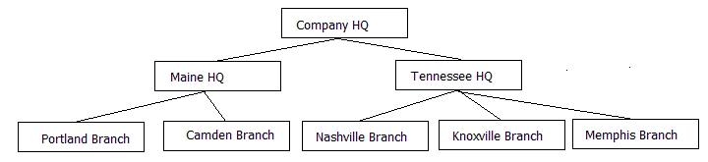
Hierarchies
Trees - Single Parent Hierarchies
Graphs – Multi Parent Hierarchies
Note: Graphs are quite complex to deal with as a whole, but often you can deal with them as a set of trees
Wood with Tape
Screw and Tape
Piece of Wood
Tape
Screw

Slide 50
Cycles in Hierarchies
Grandparent
Parent
Child
AKA: “I’m my own grandpa” syndrome
Will generally cause infinite loop in processing

Slide 51
Hierarchy Uses
Trees
Species
Jurisdictions
“Simple” Organizational Charts (Or at least the base manager-employee part of the organization)
Directory folders
Graph
Bills of materials
Complex Organization Chart (all those dotted lines!)
Genealogies

Slide 52
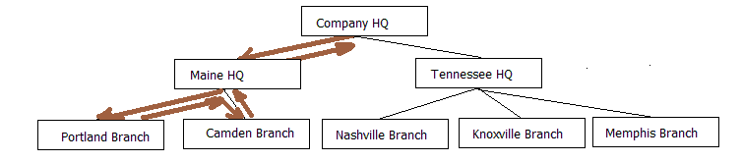
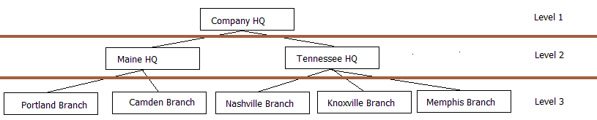
Processing a Tree
The natural way
The relational way

Slide 53
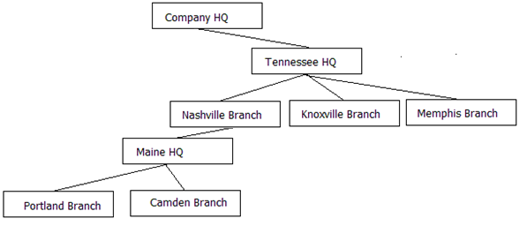
Changing Parent Row (Reparenting)
Starting with:
Perhaps ending with:

Slide 54
Implementing a tree – Fixed Levels
CREATE TABLE CompanyHierarchy ( Company varchar(100) NULL, Headquarters varchar(100) NULL, Branch varchar(100) NULL )
Very limited, but very fast and easy to work with.

Slide 55
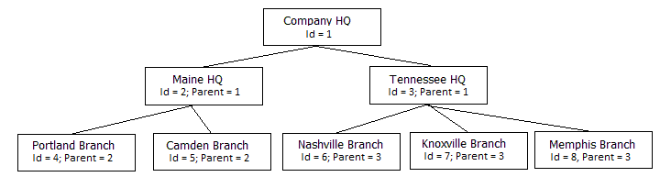
Implementing a tree – Adjacency List
Every row includes the key value of the parent in the row
Parent-less rows have no parent value
CREATE TABLE CompanyHierarchy ( Organization varchar(100) NOT NULL, ParentOrganization varchar(100) NULL )

Slide 56
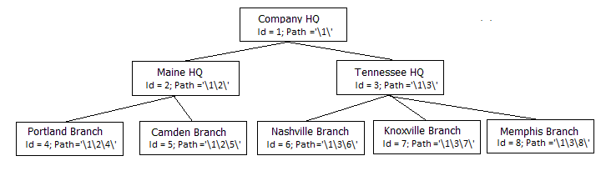
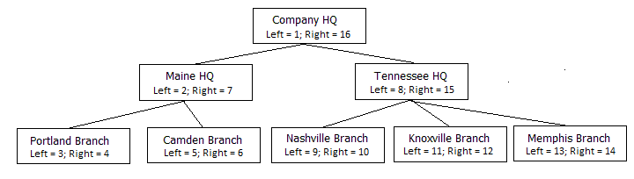
Implementing a tree - Alternatives
Using Path Technique (can be done using hierarchyId)
Nested Sets

Slide 57
Implementing a tree - Alternatives
Kimball Helper Table (Expansion of structure)
ParentId | ChildId | Distance | ParentRootNodeFlag | ChildLeafNodeFlag
1 | 2 | 1 | 1 | 0
1 | 4 | 2 | 1 | 1
1 | 5 | 2 | 1 | 1
2 | 4 | 1 | 0 | 1
2 | 5 | 1 | 0 | 1

Slide 58
Example code for each type available in download

Slide 59
Relational vs. Dimensional
Relational
Focus is on recording state: actions, properties, settings, etc
Based on the concept of tables, formatted using rules of “normalization”
Dimensional
Focus is on reporting the value of actions
Goal is to enhance reporting by allowing super fast categorization of actions
Based on a similar, but essentially different paradigm (and often toolset) than relational

Slide 60
Dimensional Design
Fact tables represent some action/business process
Dimension tables represent characteristics of an object involved in the process represented in the fact
Reading dimensional database is very fast
Queries ideally radiate from fact tables
Allows point in time/temporal queries in a very natural way

Slide 61
Dimensional Design
Writing to dimensional database is a specialized process because of
Duplication of values, eliminating codes and unreadable values. Goal is a flat structure with only single relationships radiating from fact
Maintaining temporal aspects
Each fact row may represent both current and historical state
One change in source can cause many updates in dimensional db
Note: Should not be considered “De-Normalized”, rather a completely different pattern (otherwise you will feel “dirty”)

Slide 62
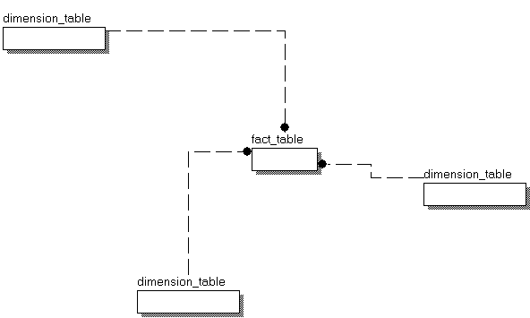
Dimensional Example

Slide 63
SELECT dd.MonthValue, dm.InsuranceNumber, dat.AdjudicationType ,
dp.OrganizationName, ddiag.DiagnosisCode,
SUM(fcp.ClaimAmount) AS ClaimAmount ,
SUM(fcp.AutoPayoutAmount) AS AutoPaymountAmount ,
SUM(fcp.ManualPayoutAmount) AS ManualPayoutAmount ,
SUM(fcp.AutoAdjudicatedCount) AS AutoAdjudicatedCount ,
SUM(fcp.ManualAdjudicatedCount) AS ManualAdjudicatedCount ,
SUM(fcp.DeniedCount) AS DeniedCount
FROM fact.ClaimPayment fcp
INNER JOIN dim.Date dd ON fcp.DateKey = dd.DateKey
INNER JOIN dim.Member dm ON fcp.MemberKey = dm.MemberKey
INNER JOIN dim.AdjudicationType dat
ON fcp.AdjudicationTypeKey = dat.AdjudicationTypeKey
INNER JOIN dim.Provider dp ON fcp.ProviderKey = dp.ProviderKey
INNER JOIN dim.Diagnosis ddiag
ON fcp.DiagnosisKey = ddiag.DiagnosisKey
GROUP BY dd.MonthValue , dm.InsuranceNumber , dat.AdjudicationType ,
dp.OrganizationName , ddiag.DiagnosisCode
Runnable code available in download

Slide 64
Images, Documents and Other Files
Relational databases are most comfortable when storing numbers and text
Associating Images to rows in the database has long been a common need
Customer logo, security images
Near term needs is expanding to make document storage common place
In SQL Server, Images, Documents, and all “files” are stored as binary values
Can be indexed for searching and manipulating using full text search
Plain text/XML files are the exception (text stored as string, XML has optimized datatype)

Slide 65
Binary File storage Criteria
Primary choice:
Storing image somewhere else, using SQL Server to store a path reference to the file data
Storing the binaries using SQL Server’s storage engine
Storing Binaries In SQL Server leads to more choices
Simple varbinary(max) column – 2GB Limit
Varbinary(max) column using filestream storage
Filetable - essentially varbinary(max) filestream column with non-transactional (Windows) access

Slide 66
Binary File Implementation Criteria
Security – Is it essential that the image is in sync with the related data (example: image of person for guard system)
Consistent backup of image and data – What happens if the image server crashes. Can you get them back in sync?
Size - For sheer speed of manipulation, for the typical object size less than 1MB, Books Online suggests using storage in a ­varchar(max). If objects are going to be more than 2GB, you must use one of the filestream storage types.

Slide 67
Binary File Implementation Criteria
API - Which API is the client using?
Utilization - How will the data be used?
Location of files - Will there be too many to host on SQL Machine?
Encryption - Encryption is not supported on the data store in filestream filegroups, even when transparent data encryption (TDE) is enabled.

